Slide 1

MATH-810:Mathematical Methods for AI
Lecture # 1: Introduction to MMAI
Instructor: Dr. Soyiba Jawed

Slide 2
Course Format
Course Outline
Available on LMS
Office Hours
Wednesday 16:00 – 18:00
Also, Available on email

Slide 3
Course Format
Assessments
Quizzes
Assignments &Projects
Mid Term and Final Exam
Assignments and Projects
Theoretical, conceptual, coding based
Project
Apply AI techniques on a problem dataset of your interest
Group of 2 students or one student

Slide 4
Math-810 MMAI
Welcome to a fun, but challenging course
•Goal: Learn about MM Artificial Intelligence
Prepare you for the topics courses
Broad coverage of topics
NOT a current events class
LMS
Enrolment Code: 548207169
Email: soyiba.jawed@ceme.nust.edu.pk

Slide 5
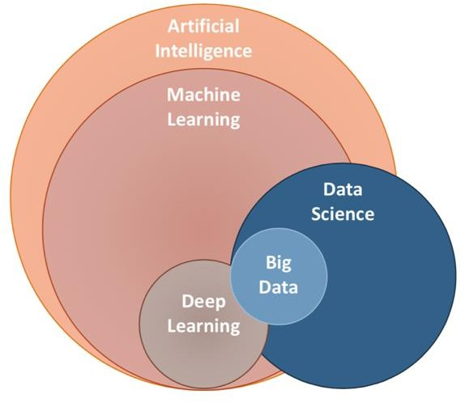
Overview
Is it possible to learn artificial intelligence without mathematical knowledge?

Slide 6
AI and Machine Learning
Data
visualizations, operations, manipulations
Analysis
insights, statistics, inference
Model
representation of process, assumptions
Learning
Optimize model with respect to data
Linear Algebra
Analytic
Geometry
Calculus
Probability Theory

Slide 7
“As to methods, there may be a million and then some, but principles are few. The man who grasps principles can successfully select his own methods.”
Ralph Waldo Emerson

Slide 8
AI Overview
What is Intelligence?
“Intelligence is the ability to learn, understand, and apply knowledge to
adapt to new situations, reason, and solve problems.”
Human Intelligence
Problem-solving and reasoning
Learning from Experience
Adaptability
Emotional Intelligence

Slide 9
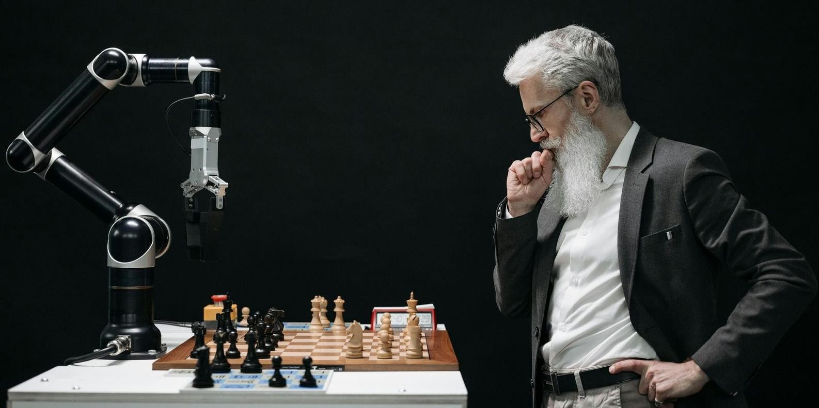
AI Overview
What is Artificial Intelligence (AI)?
“AI refers to the simulation of human intelligence in machines that are
programmed to think and learn like humans.”
Narrow AI vs General AI
SuperIntelligence
The term AI was coined in 1956 by John McCarthy at a conference.

Slide 10
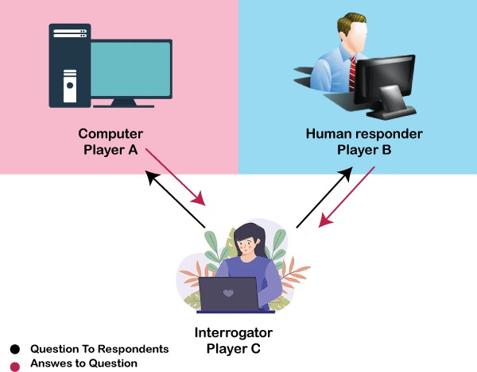
AI Overview
History of AI – Turing Test
Alan Turing (1950) "Computing machinery and intelligence"
Can machines think or behave intelligently?
The Turing Test (imitation game) was designed as a way to judge the success or otherwise of an attempt to produce a thinking computer.
Predicted that by 2000, a machine would have a 30%
chance of fooling a person for 5 minutes
What do you think?

Slide 11
AI Overview
History of AI – 1960s to 1990s
Since the 1950s, much of the initial optimism surrounding AI has given way to a more realistic perspective.
Key areas of focus include:
Machine learning
Multi-agent systems
Computer vision
Planning
Game Theory
Optimization, …
1997 (IBM’s Deep Blue), 2012 (Deep Learning breakthrough).

Slide 12
Applications of AI
AI in Healthcare
AI-powered Diagnostics
AI systems can analyze medical images, such as X-rays, MRIs, and CT scans, to detect diseases like cancer, heart conditions, and more.
These systems can identify patterns that might be missed by human eyes,
resulting in earlier and more accurate diagnoses.
Example: Google's DeepMind developed an AI system capable of diagnosing eye diseases with an accuracy that matches world-leading doctors.

Slide 13
Applications of AI
AI in Healthcare
Predictive Analytics
AI can analyze patient data and predict potential health risks, such as the likelihood of developing chronic diseases like diabetes or heart disease. This helps doctors create personalized treatment plans and intervene early.
Example: IBM Watson Health analyzes vast datasets to predict disease
progression and recommend personalized treatment options.

Slide 14
Applications of AI
AI in Healthcare
Robotic Surgery
AI-powered robotic systems assist in precision surgeries, allowing for less invasive procedures, faster recovery times, and reduced human error.
Example: The da Vinci Surgical System uses AI to enhance the precision and
control of surgeons during minimally invasive procedures.

Slide 15
Applications of AI
AI in Healthcare
Drug Discovery and Development
AI accelerates the drug discovery process by analyzing complex biological data to identify new drug candidates, significantly reducing the time and cost involved in developing new treatments.
Example: AI was used by the pharmaceutical company Insilico Medicine to identify potential new compounds for treating fibrosis, which traditionally would have taken years.

Slide 16
Applications of AI
AI in Healthcare
Virtual Health Assistants
AI chatbots and virtual assistants provide personalized health advice, answer questions, and help patients manage chronic conditions by monitoring symptoms and offering medication reminders.
Example: AI-driven platform allows patients to receive medical advice through
their smartphones based on the symptoms they input.

Slide 17
Applications of AI
AI in Education
Personalized Learning Systems
Virtual Tutors and Chatbots
AI in Assessments and Grading
AI in Special Education

Slide 18
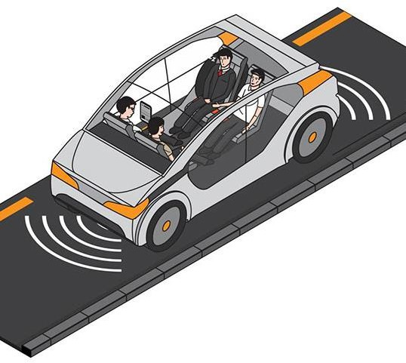
Applications of AI
AI in Autonomous Vehicles
Deep Learning for Object Detection
Decision Making and Planning (Reinforcement Learning)
Simultaneous Localization and Mapping (SLAM)
Path Planning and Navigation
To name a few…

Slide 19
Applications of AI
AI in Retail
Personalized product recommendations
AI-powered chatbots and virtual assistants
Inventory management and demand forecasting
Dynamic pricing
Visual search and image recognition
Customer sentiment analysis

Slide 20
Applications of AI
AI in Agriculture
Precision farming
Crop monitoring and disease detection
Soil health monitoring and analysis
Automated machinery and robotics
Predictive analytics and yield forecasting

Slide 21
Applications of AI
AI in NLP
Virtual assistants (e.g., Siri, Alexa)
Language translation
Text generation and summarization
Speech recognition and transcription
Sentiment analysis
Chatbots for customer support

Slide 22
Applications of AI
AI in Manufacturing
Predictive maintenance
Quality control and defect detection
Supply chain optimization
Autonomous robots and cobots (collaborative robots)
Inventory management and optimization
Production scheduling and process optimization

Slide 23
Applications of AI
AI in Urban Development
Traffic management and optimization
Smart energy grids and resource management
Road safety and surveillance
Waste management optimization
Smart infrastructure and building management
Environmental monitoring

Slide 24
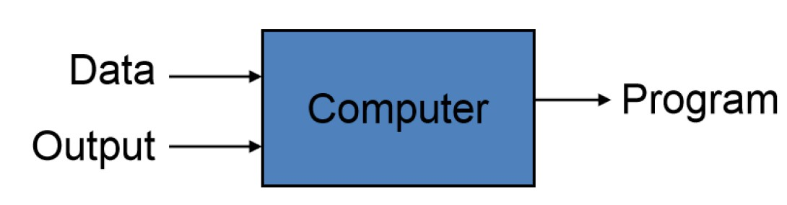
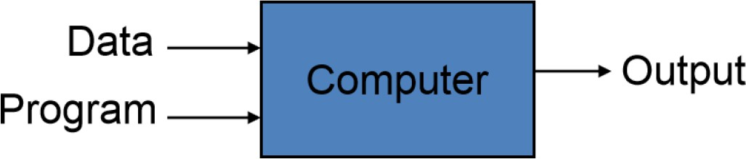
Machine Learning Overview
What is Machine Learning?
Automating the process of automation
Getting computers to program themselves
Traditional Programming
Machine Learning
Given examples (training data), make a machine learn system behavior or discover patterns

Slide 25
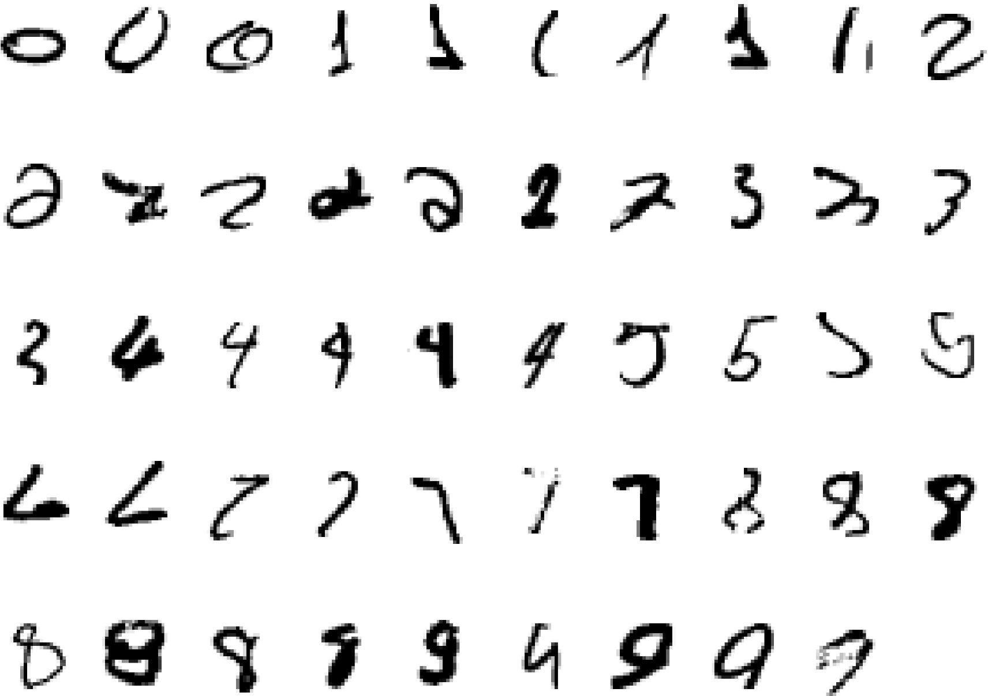
Machine Learning Overview
Classical Example: Recognize hand-written 2!

Slide 26
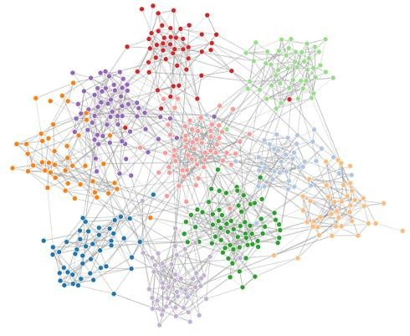
Machine Learning: Overview
What is Machine Learning?
Given examples (training data), make a machine learn system
behavior or discover patterns
Data
Model
f (x)
Algorithm
Final output which enables us to make predictions
Given to us
We need to design it

Slide 27
Machine Learning: Overview
Nature of ML Problems
1. Supervised Learning
The learning algorithm would receive a set of inputs along with the corresponding correct outputs to train a model
Training Data
All labeled data
Model
Prediction

Slide 28
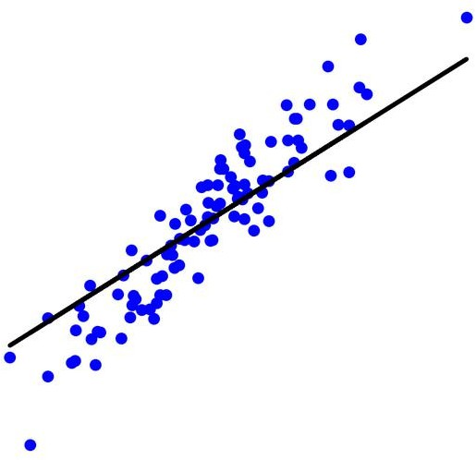
Supervised Learning
Regression
Regression: Quantitative Prediction on a continuous scale
Examples: Prediction of
Age of a person from his/her photo
Price of 10 Marla, 5-bedroom house in 2050
USD/PKR exchange rate after one year
Efficacy of vaccine or medicine
Average temperature/Rainfall during monsoon
Cumulative score in AI501 course
Probability of decrease in the electricity prices in Pakistan
No. of steps per day
What do all these problems have in common?
Continuous outputs
Predicting continuous outputs is called regression

Slide 29
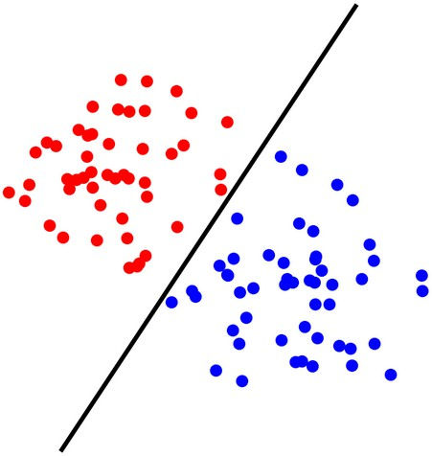
Supervised Learning
Classification
Classification: Given a data sample, predict its class (discrete)
Examples: Prediction of
Gender of a person using his/her photo or hand-writing style
Spam filtering
Object or face detection in a photo
Temperature/Rainfall normal or abnormal during monsoon
Letter grade in AI501 course
Decrease expected in electricity prices in Pakistan next year
More than 10000 Steps taken today
What do all these problems
have in common?
Discrete outputs: Categorical
Yes/No (Binary Classification)
Multi-class classification: multiple classes
Predicting a categorical output is called classification

Slide 30

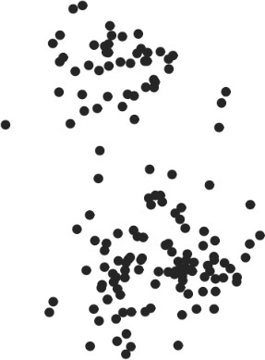
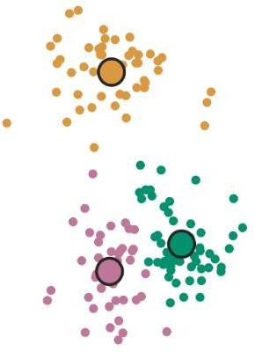
Machine Learning: Overview
Nature of ML Problems
2. Unsupervised Learning
The learning algorithm would receive unlabeled raw data to train a model and to find patterns in the data
Training Data
All unlabeled data
Model
Clustering

Slide 31

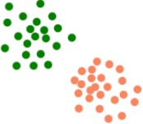
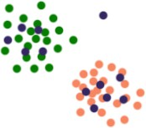
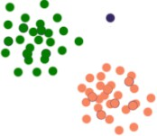
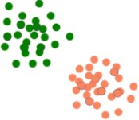
Machine Learning: Overview
Nature of ML Problems
Semi-supervised Learning
The learning algorithm receives labeled and unlabeled raw data to train a model
Main objective is to efficiently accommodate the unlabeled data
Training Data
Labeled
+
unlabeled Data
Data Modeling and Augmentation
Model
Anomaly
-> ignore it
Use labeled data to
build a model
Place unlabeled data
with model
Use the model to label
the unlabeled data
Fit the model again
with the combined data

Slide 32
Machine Learning: Overview
Training Data Collection
y
Observed Output
x
Input
Model or Process or System
PROCESS or SYSTEM : Underlying physical or logical phenomenon which maps our input data to our observed output
Collect the training data by observing our unknown PROCESS or SYSTEM

Slide 33


Machine Learning: Overview
Example Systems
Previous Sales
Prices
Inflation
Pandemic
Model
Future
sales
Image
Model
Object detection Or recognition

Slide 34


Machine Learning: Overview
Example Systems
Market segmentation based on consumers’ spending patterns
Consumer Transaction Data
Model
Income
Credit History
Employment
Marital Status
Model
Loan Approval

Slide 35
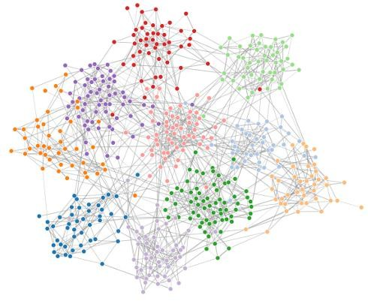


Machine Learning: Overview
Typical Flow
Problem Nature Identification
Training Data Collection
Model Training
f (x)
Model Deployment
Model
Validation

Slide 36
Supervised Learning Setup
Nomenclature
In these regression or classification problems, we have
Inputs – referred to as Features
Output – referred to as Label
Training data – (input, output) for which the output is known and is used for training a model by ML algorithm
A Loss, an objective or a cost function – determines how well a trained model approximates the training data
Test data – (input, output) for which the output is known and is used
for the evaluation of the performance of the trained model

Slide 37
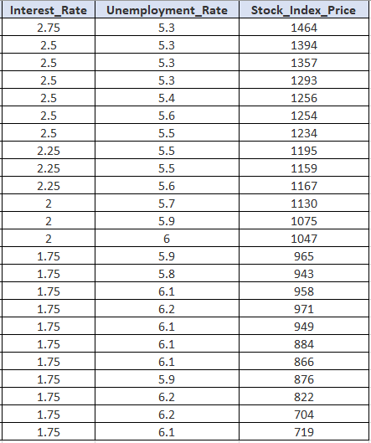
Supervised Learning Setup
Nomenclature - Example
Predict Stock Index Price
Features (Input)
Labels (Output)
Training data
?
?
?

Slide 38
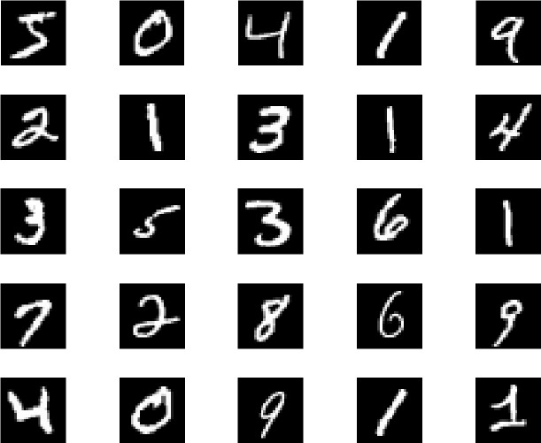

Supervised Learning Setup
Example
Model (h)
Prediction
MNIST Data:
Each sample 28x28 pixel image
60,000 training data
10,000 testing data

Slide 39
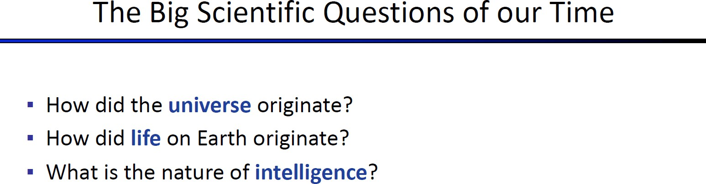

Slide 40
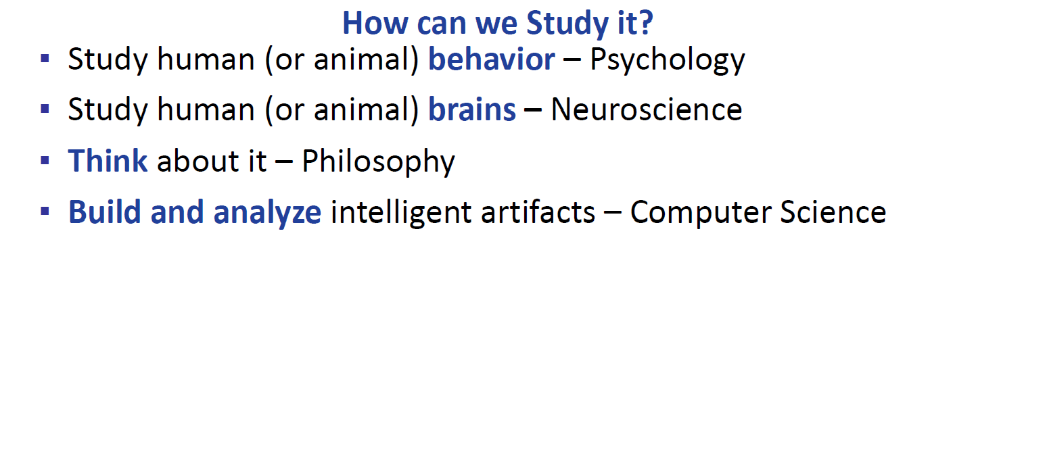

Slide 41
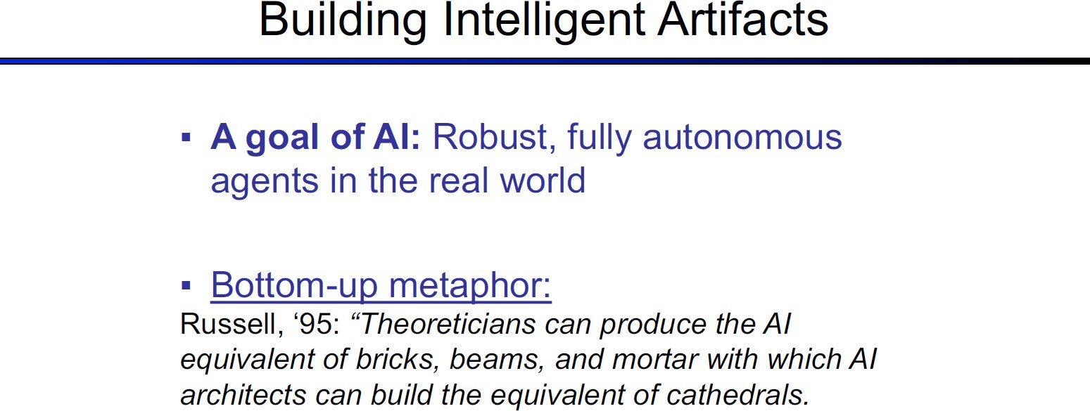

Slide 42
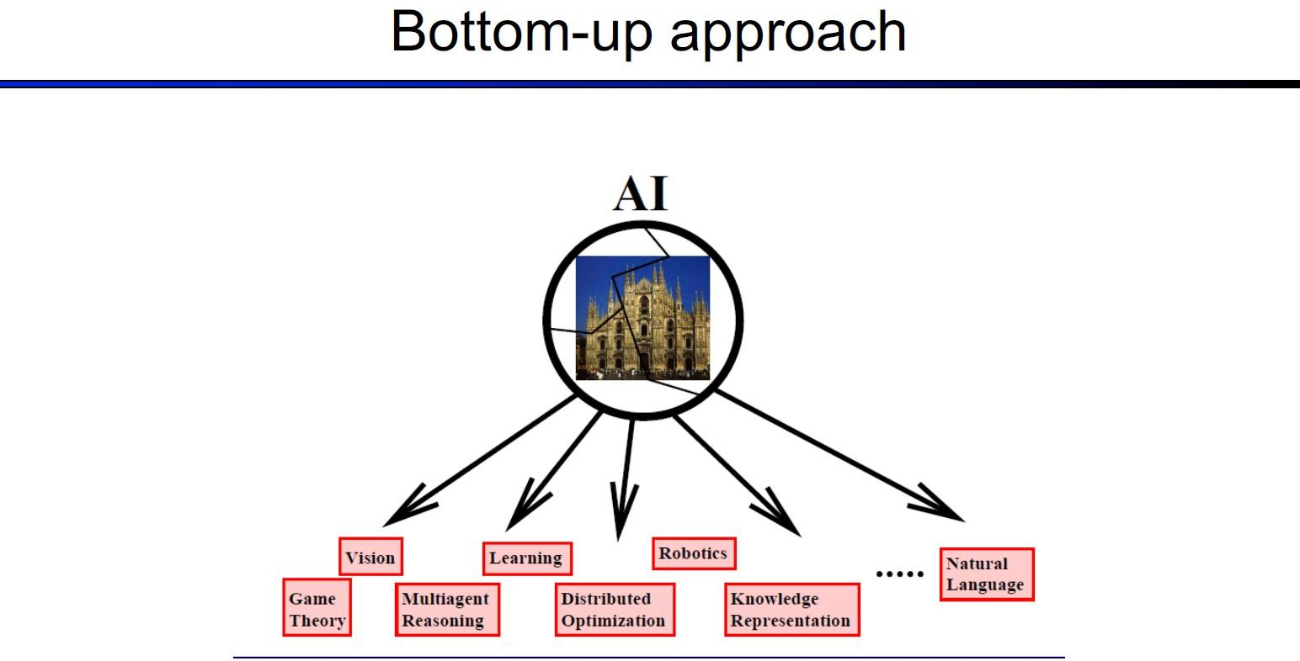

Slide 43
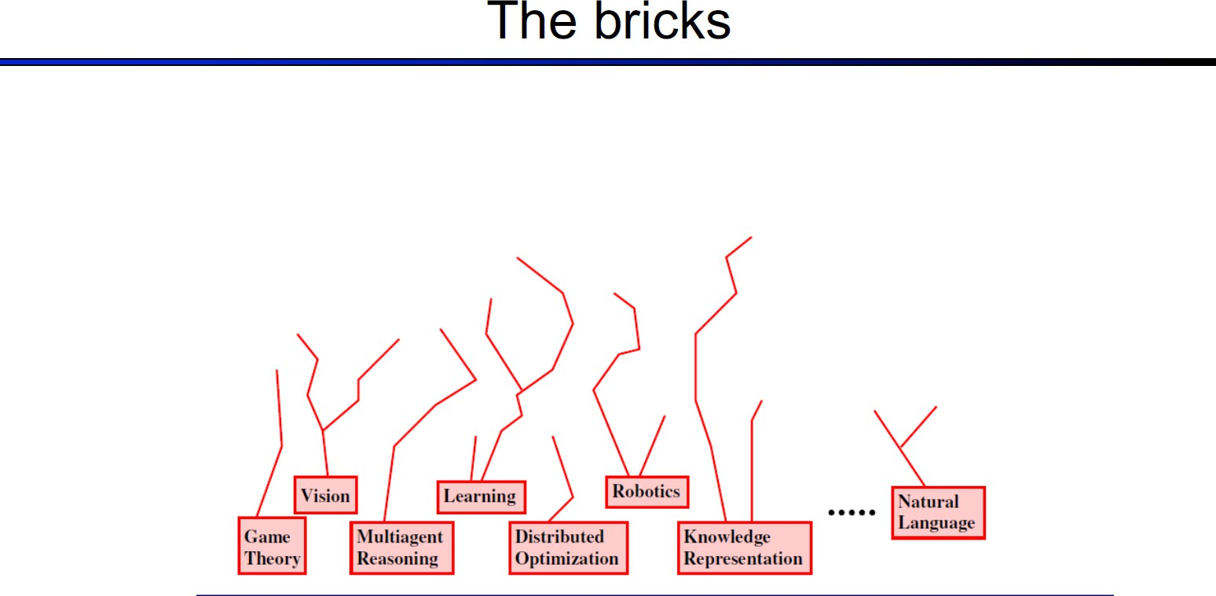

Slide 44
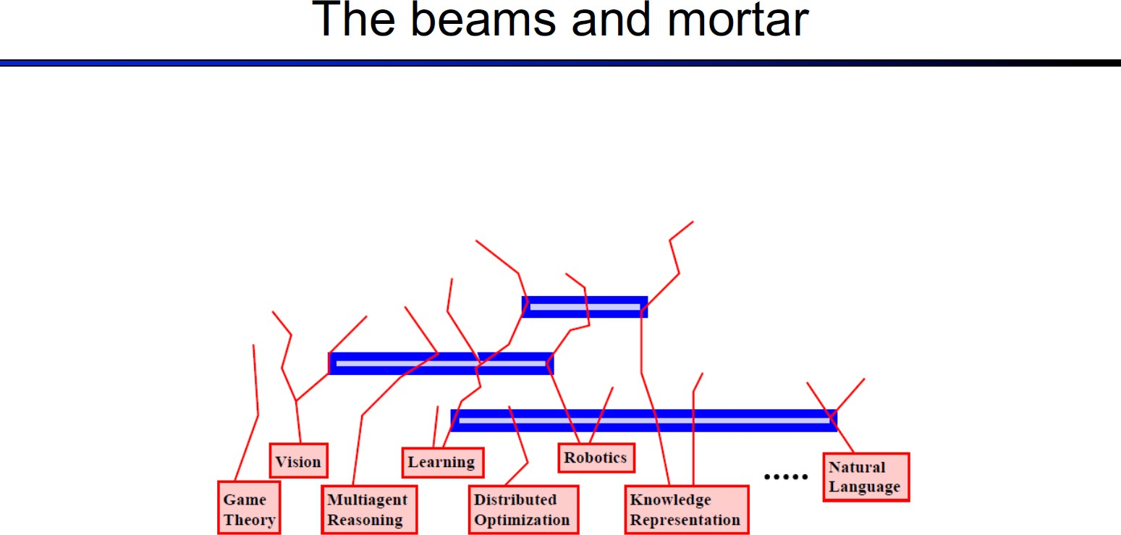

Slide 45
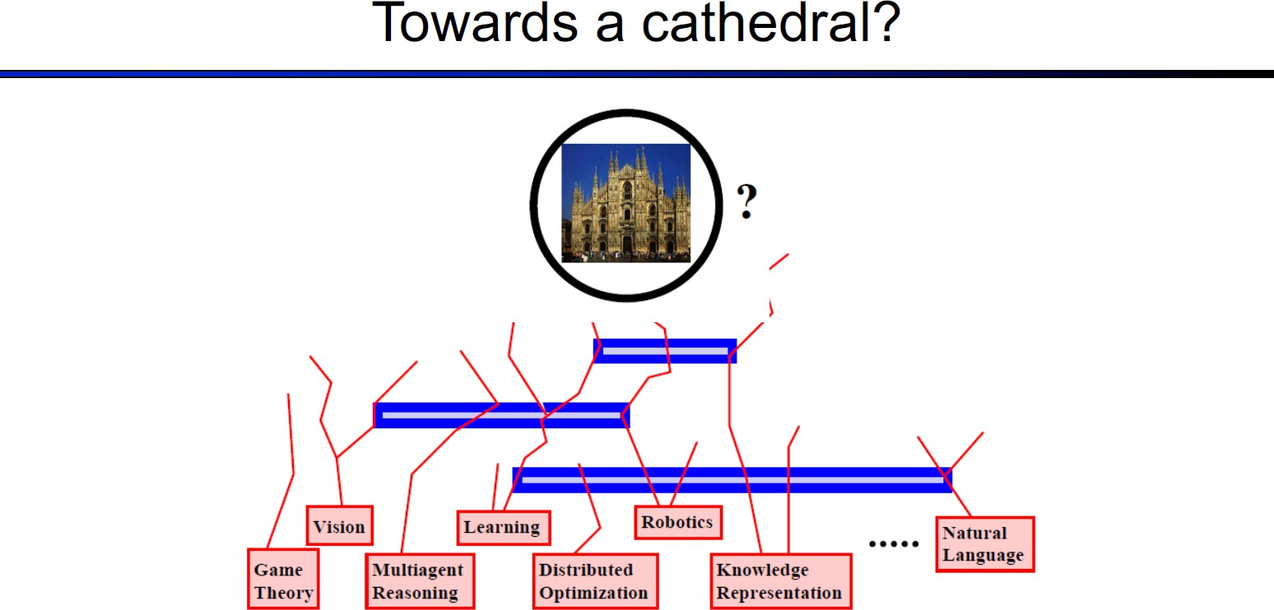

Slide 46
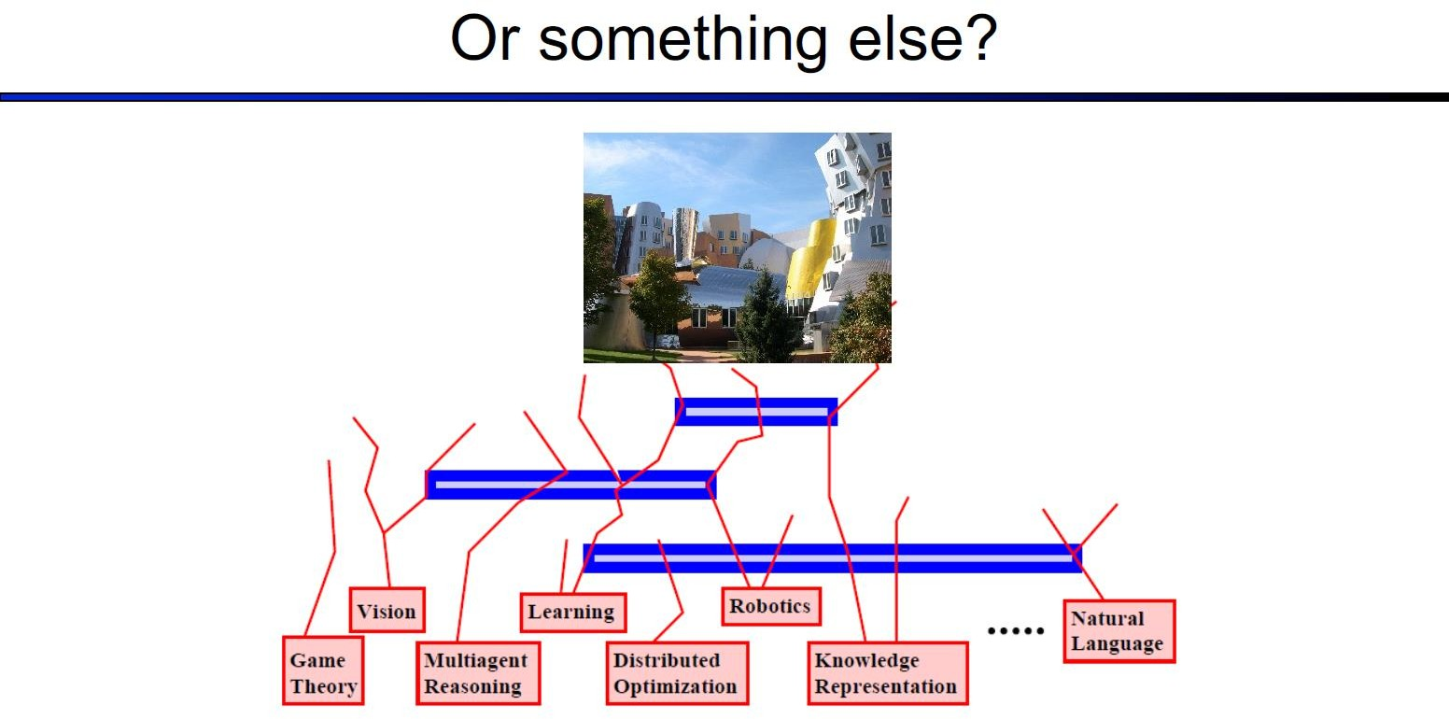

Slide 47
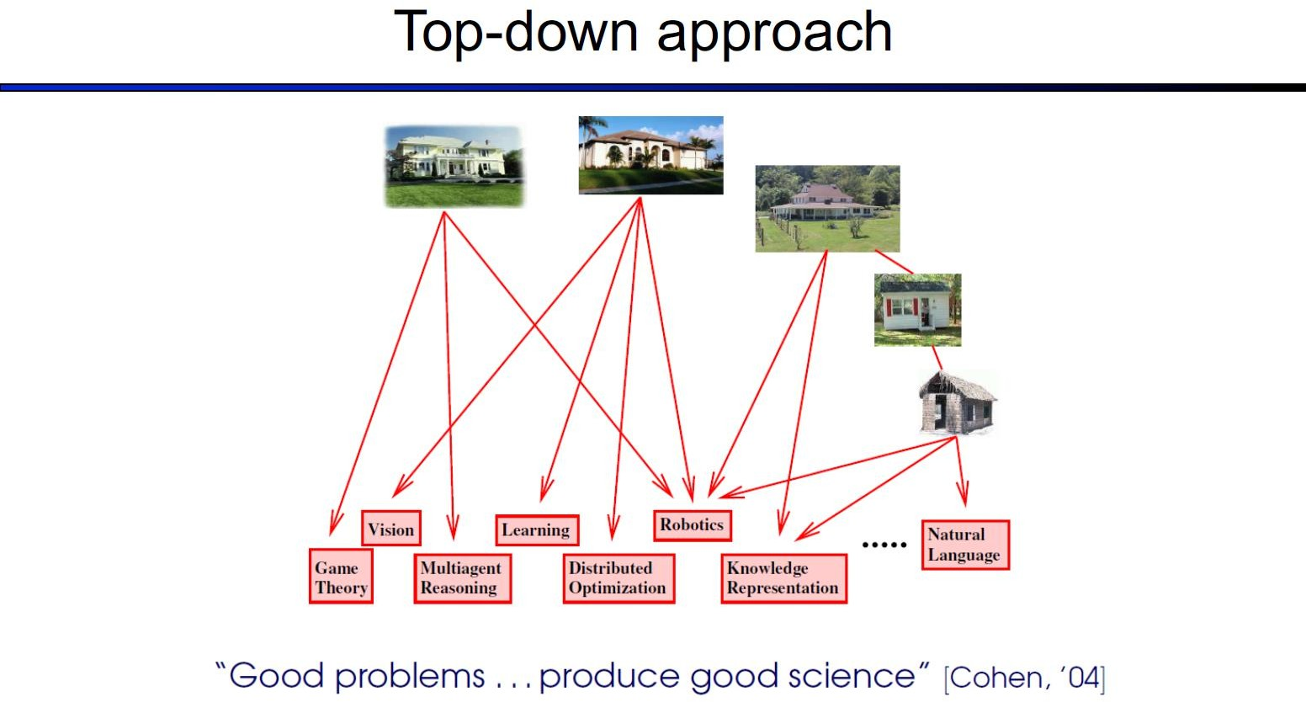

Slide 48
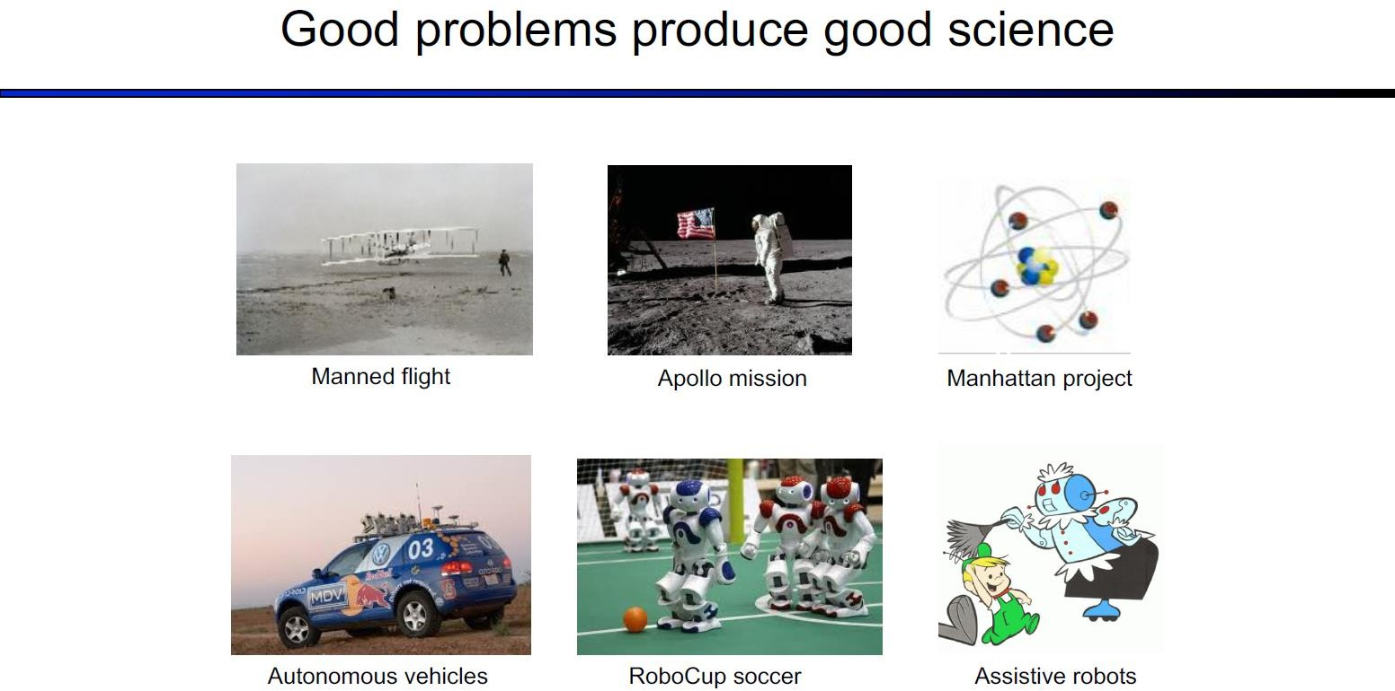

Slide 49
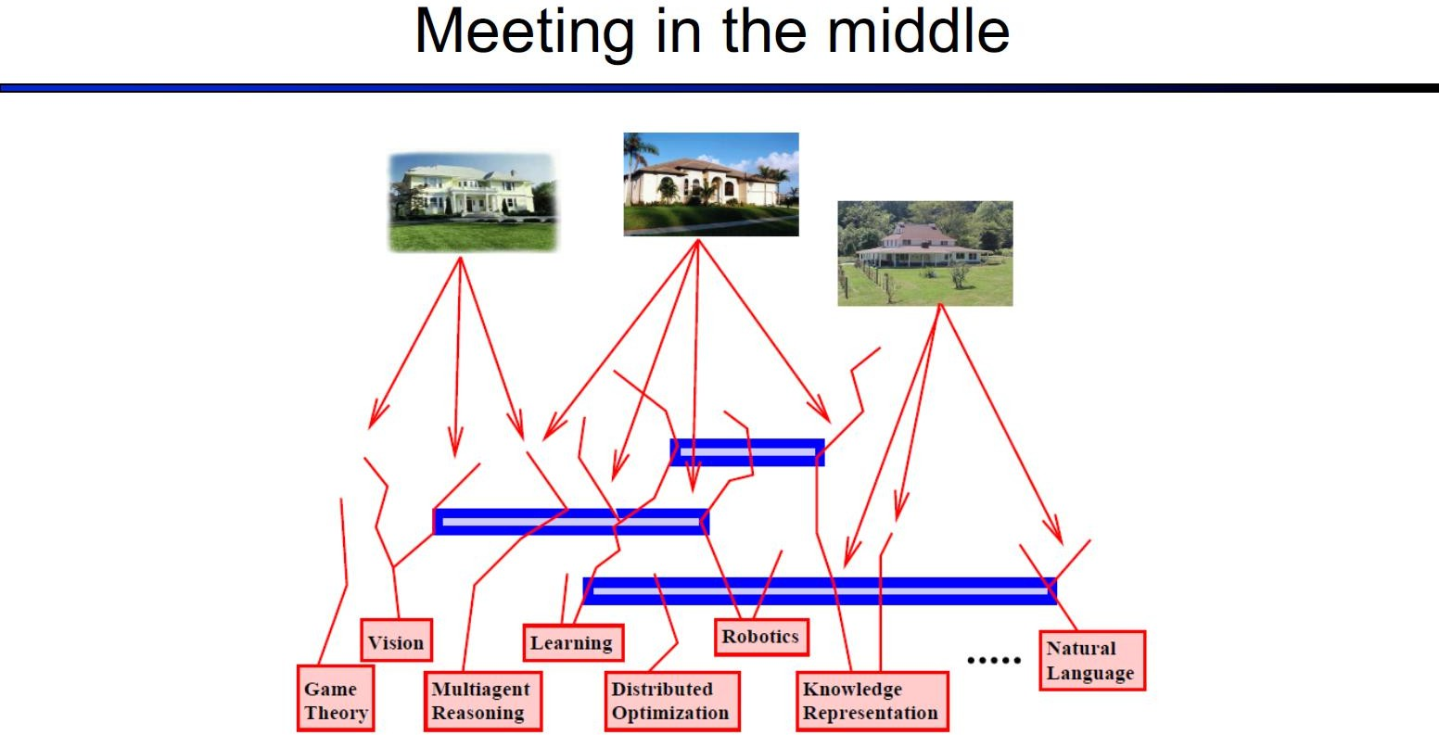

Slide 50
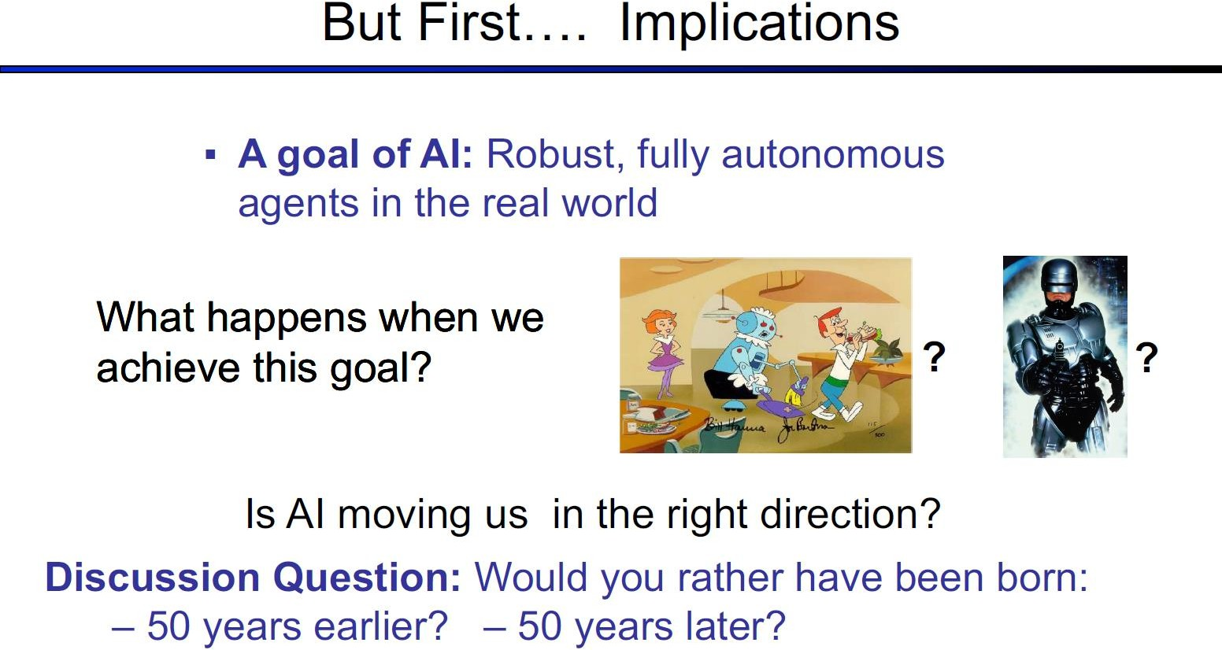

Slide 51
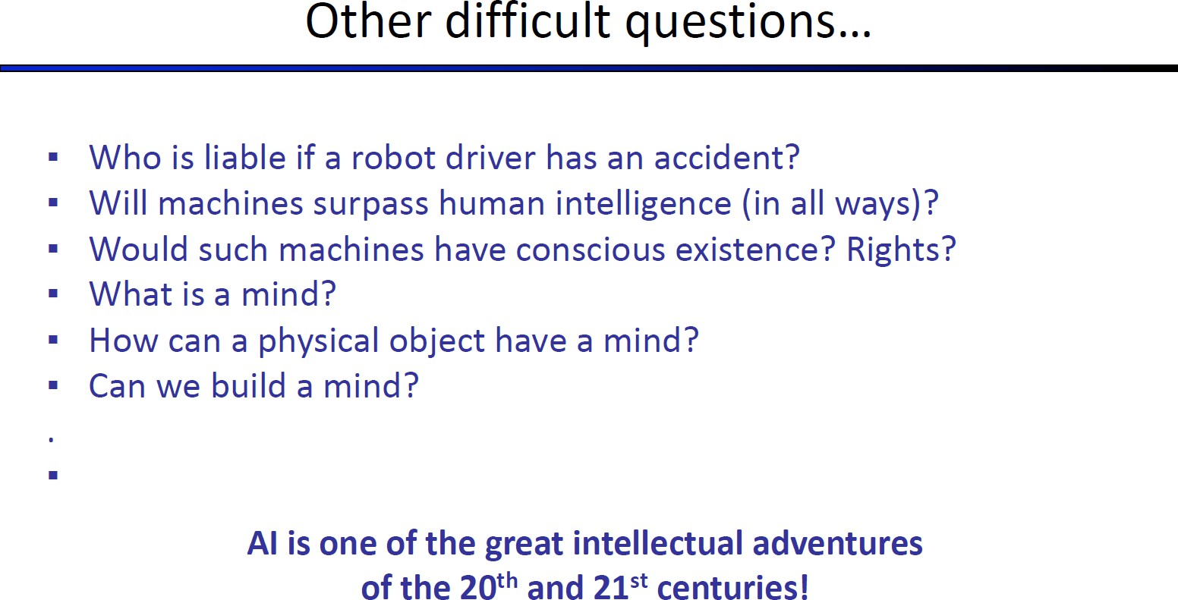

Slide 52
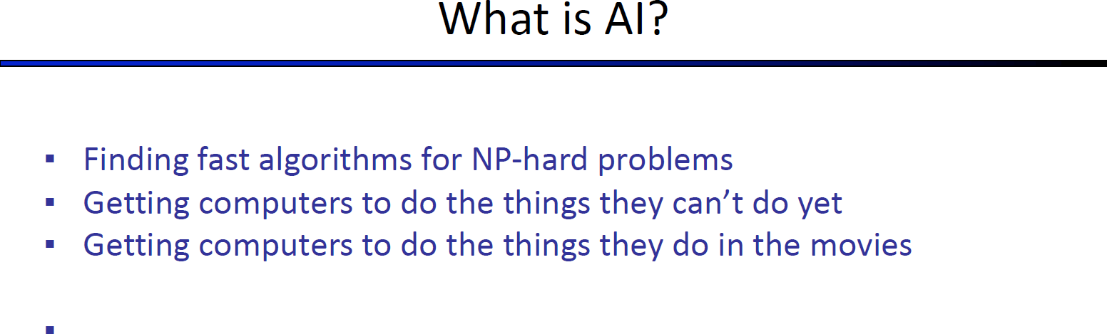

Slide 53
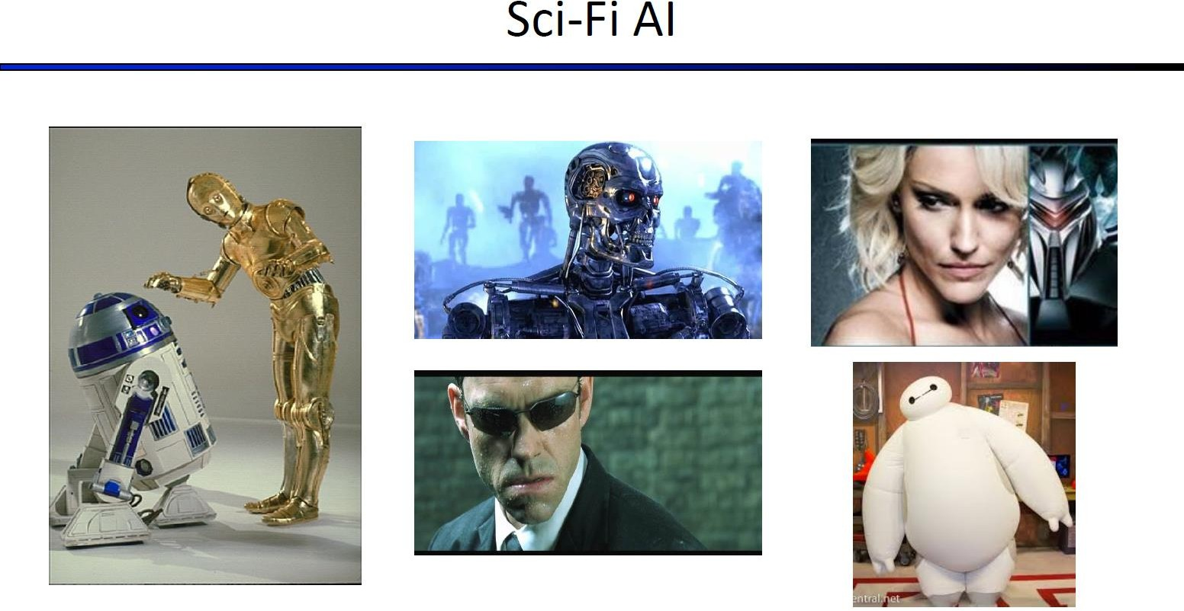

Slide 54
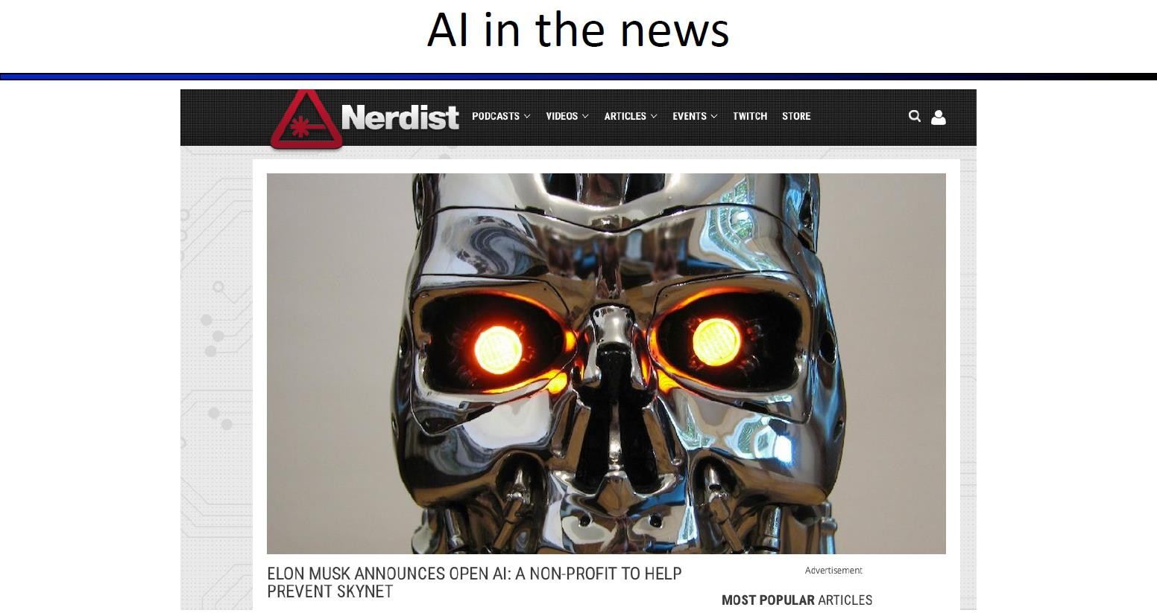

Slide 55
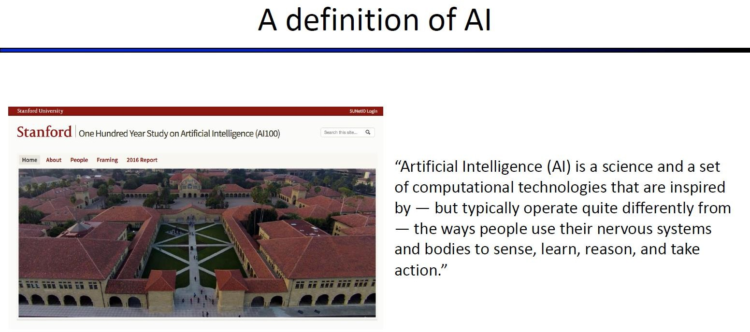


Slide 56
AI: Ethics and Society

Slide 57
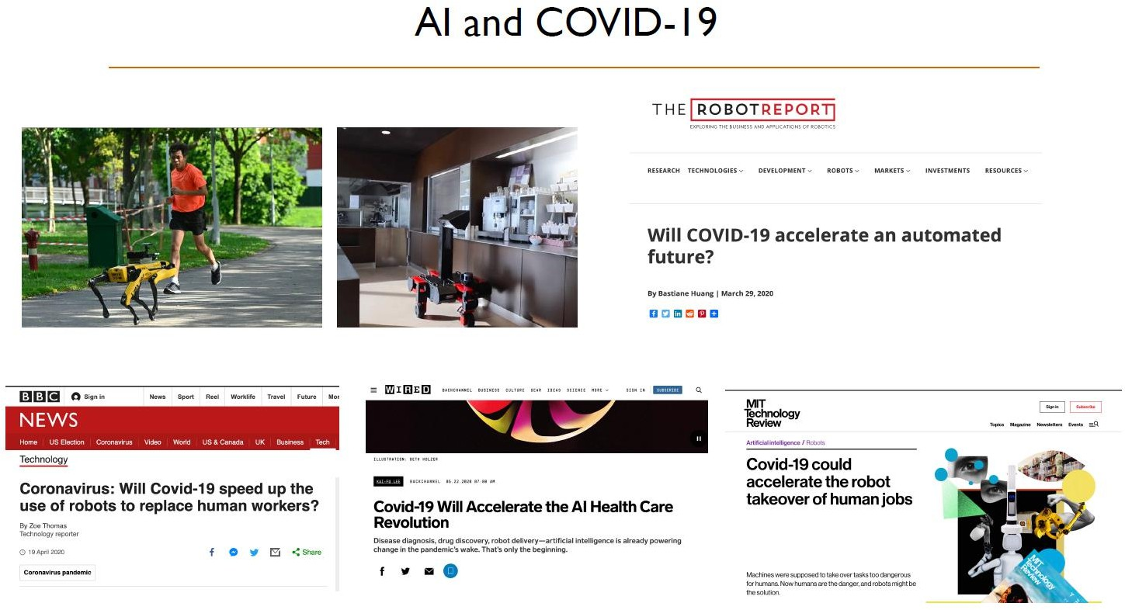

Slide 58
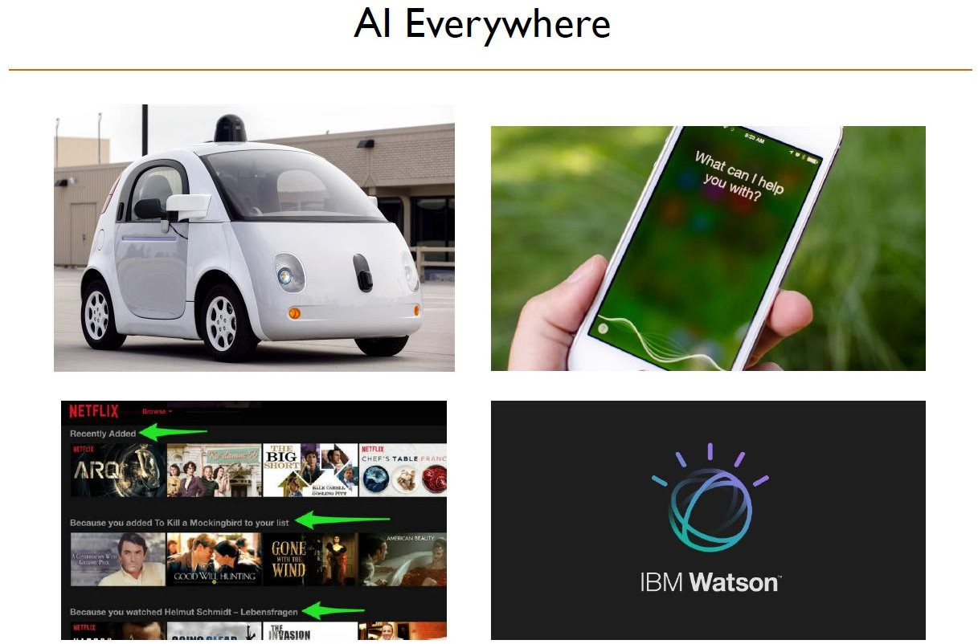

Slide 59
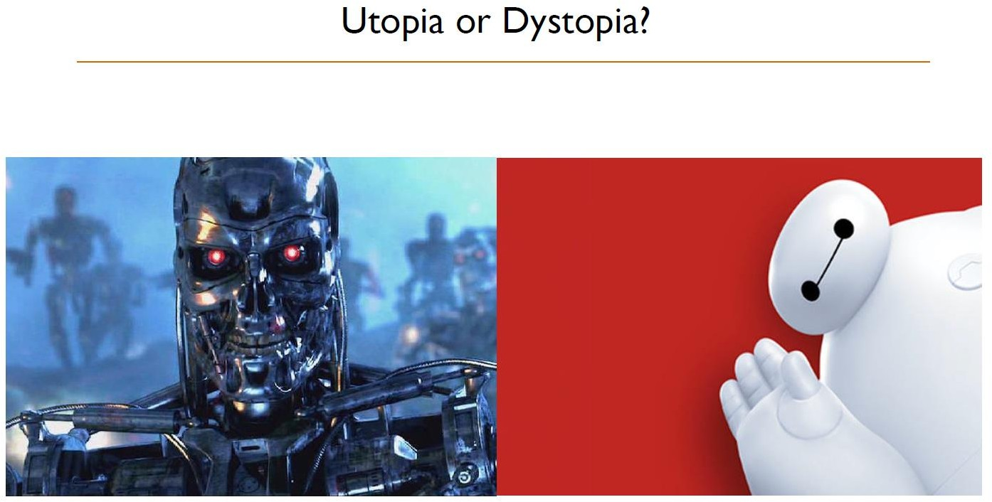

Slide 60
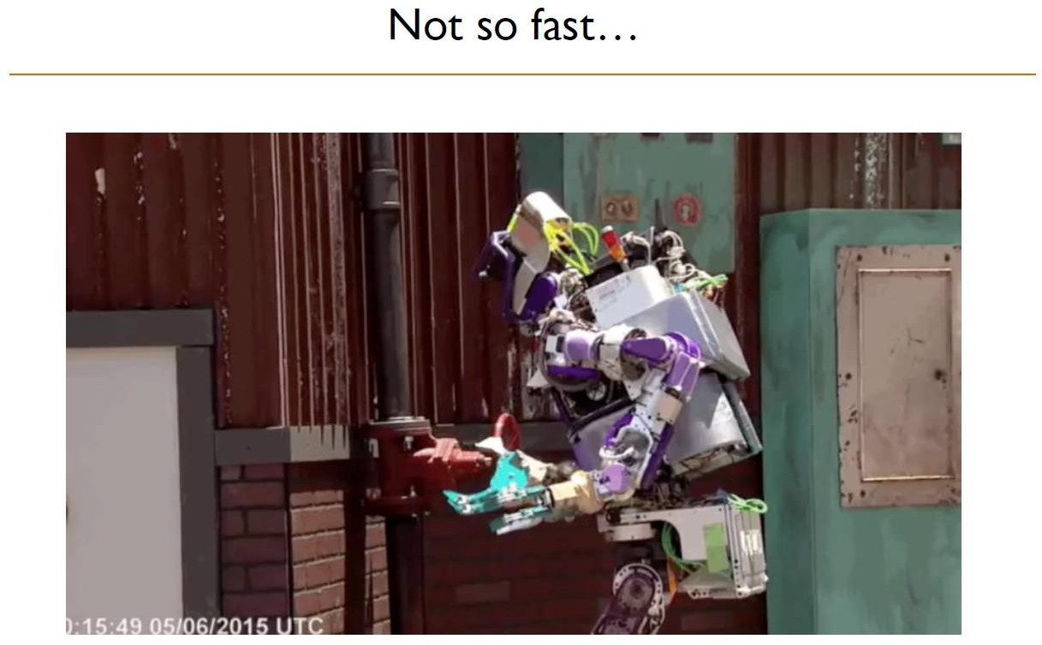

Slide 61
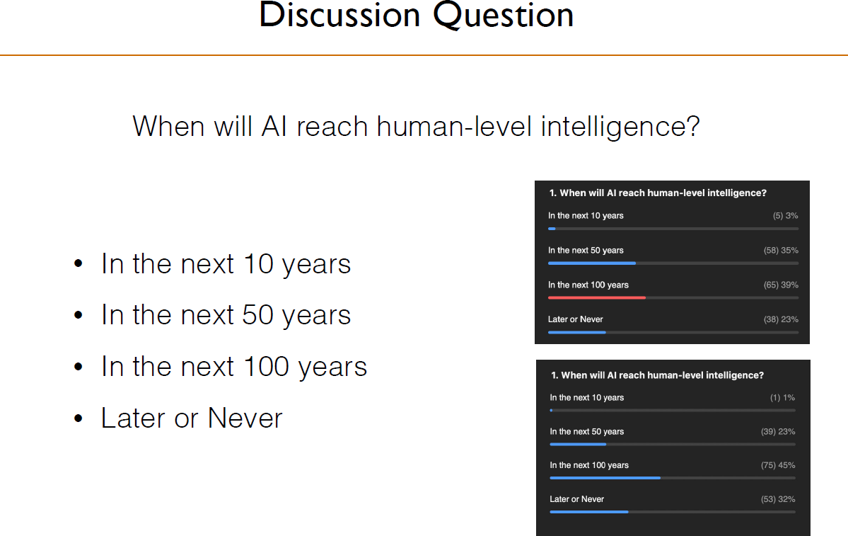

Slide 62
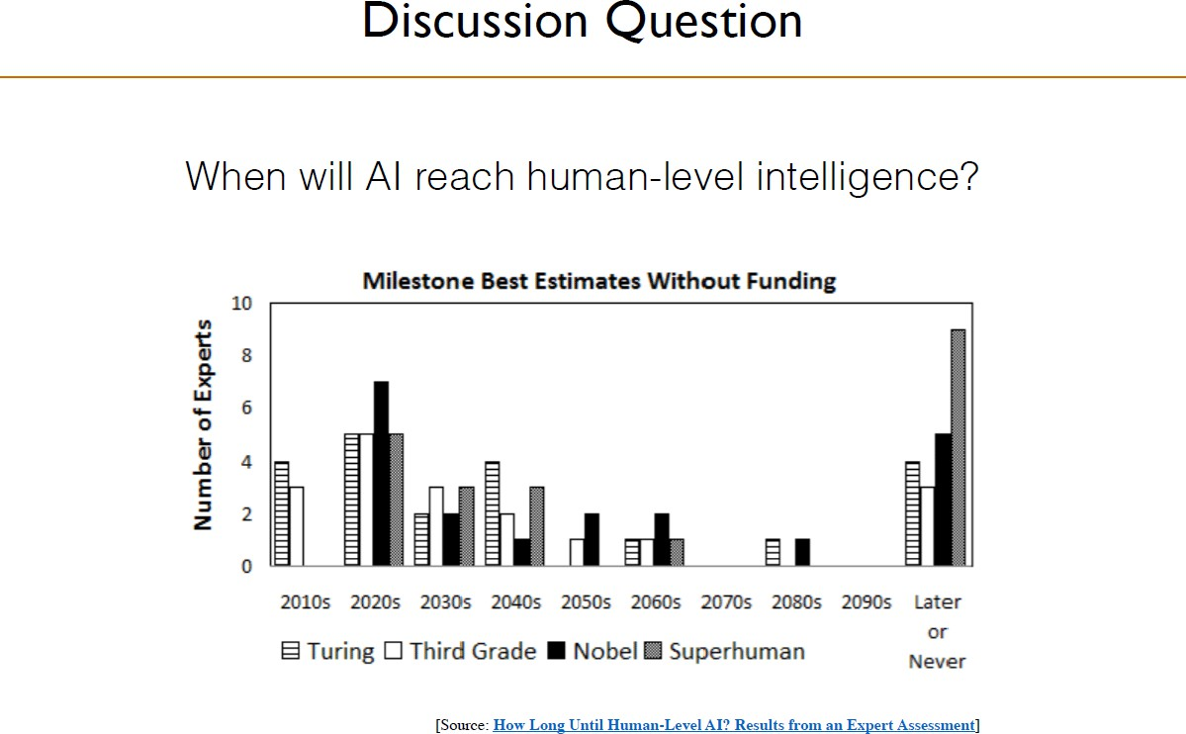

Slide 63
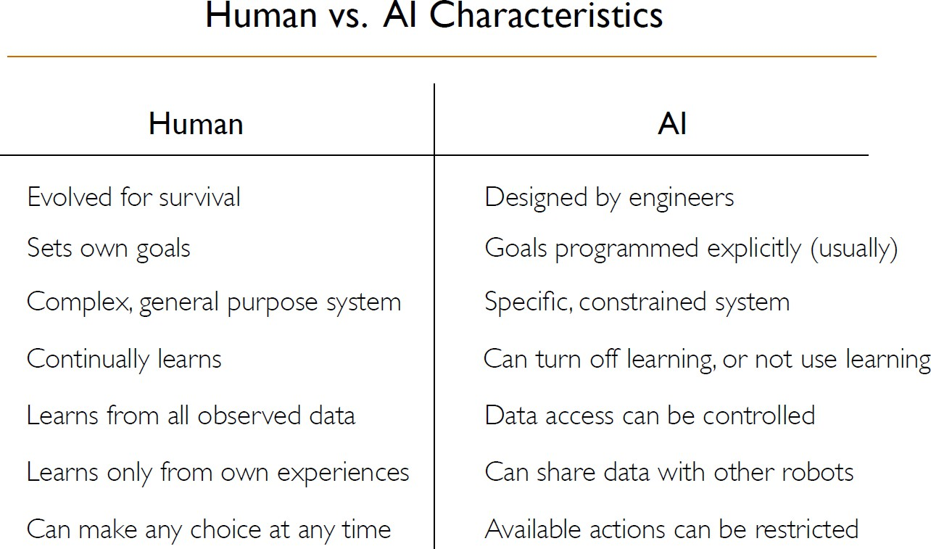

Slide 64
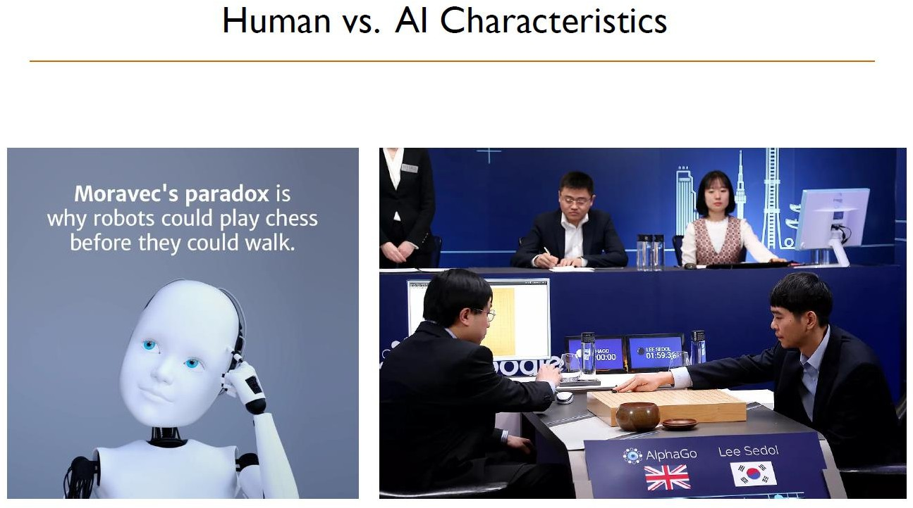

Slide 65
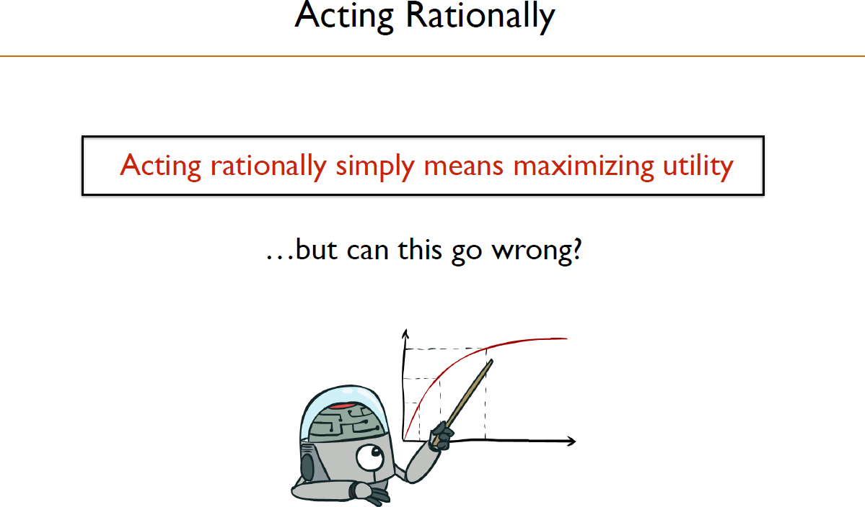

Slide 66
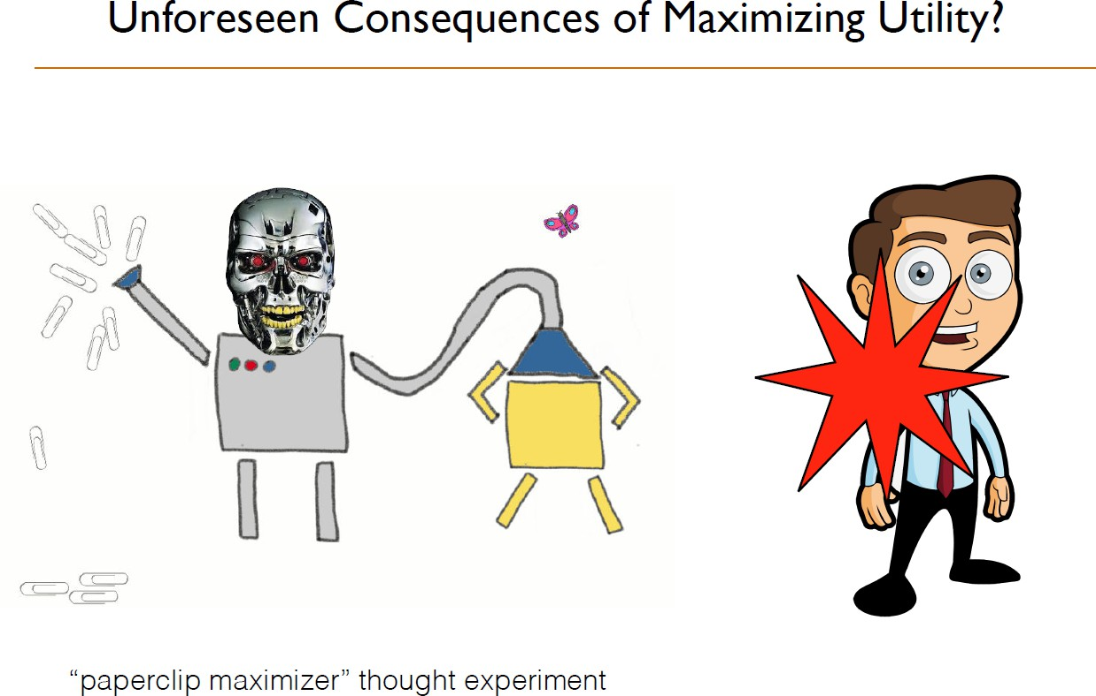
The scenario describes an advanced artificial intelligence tasked with manufacturing paperclips. If such a machine were not programmed to value human life, given enough power over its environment, it would try to turn all matter in the universe, including human beings, into paperclips or machines that manufacture paperclips.

Slide 67
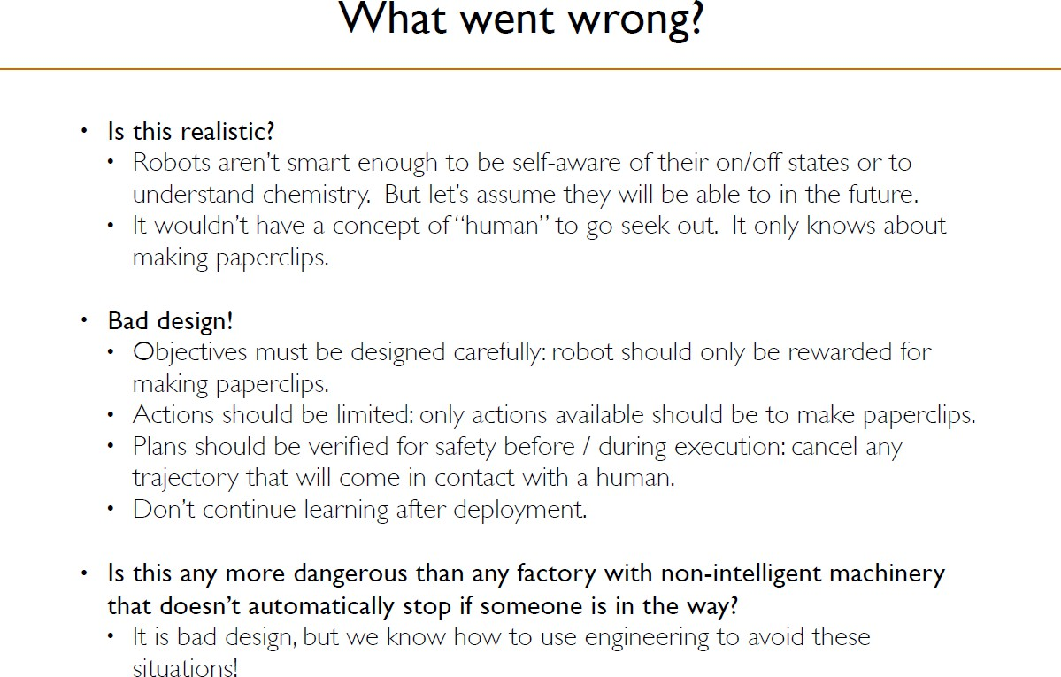

Slide 68
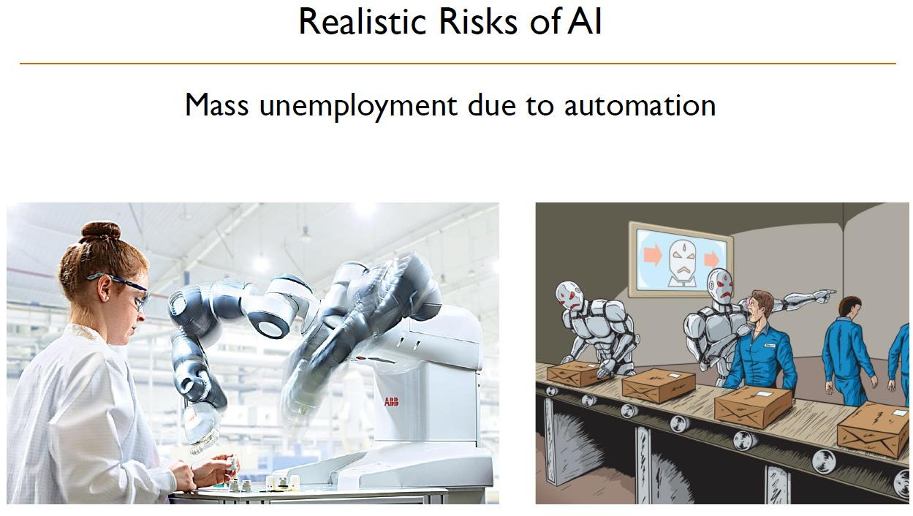

Slide 69
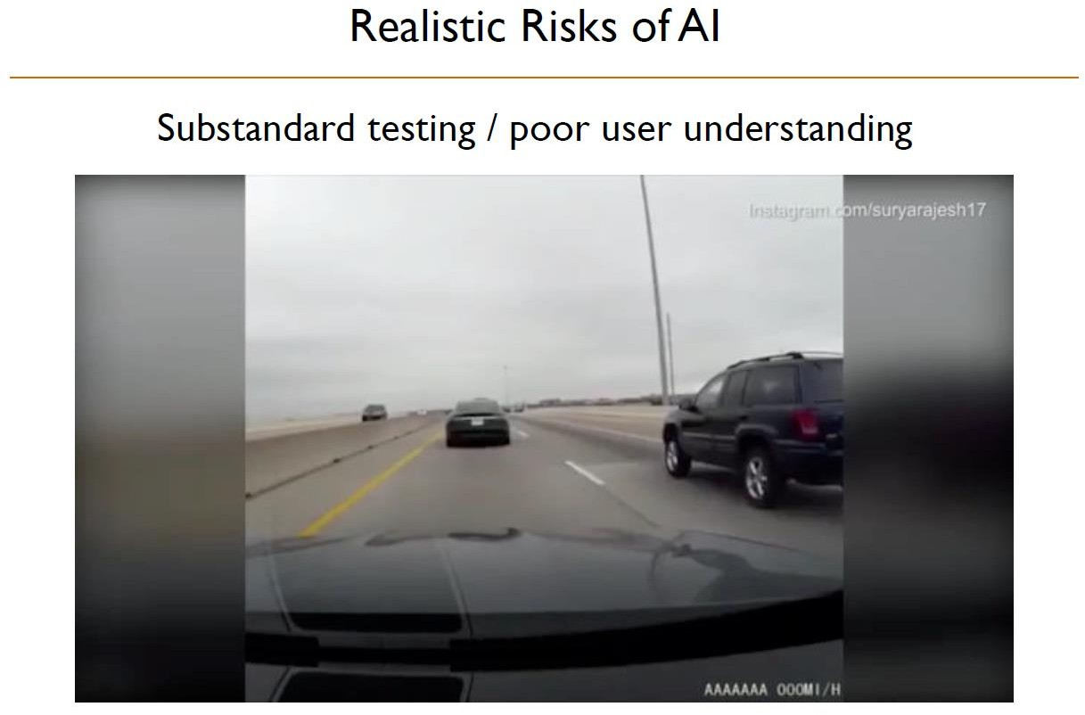

Slide 70
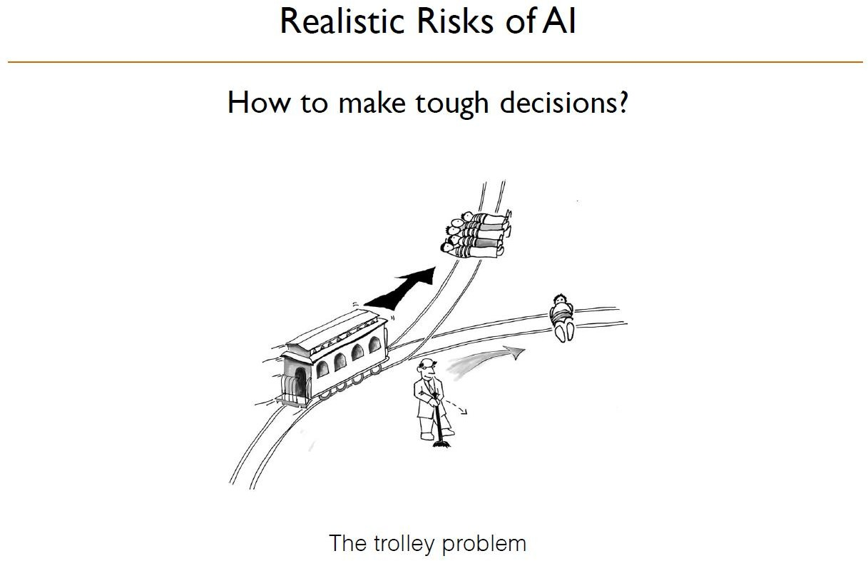

Slide 71


Slide 72


Slide 73


Slide 74


Slide 75


Slide 76


Slide 77


Slide 78


Slide 79


Slide 80


Slide 81


Slide 82


Slide 83


Slide 84


Slide 85


